Slide 1


ROAMEO
LET’S MAKE YOUR TOUR A LOT MORE FUN

Slide 2

keep thinking about the significance of the
place as you are visiting it?
want a guide to acquaint and apprise you
about the place as you travel through it?
want someone to help you make the most of
your trip?
PROBLEM AREA
Many times, while visiting a place, we tend to think of the significance (historical, geographical, cultural, etc.) of the place.
But it is very often the case that there’s no one to tell us about those places and so we don’t get to know of them.
Guides may be available but they charge a lot and many times don’t even tell the right information.
Hence, our visit to the place goes on meaningless.
Imagine if someone was there right with you always to guide you throughout your trip and to tell you amazing facts about the places as you are visiting them. Wouldn’t it make your trip 100 times more fun and interesting? YES, IT WOULD.
Hence, we present in front of you all our idea of an app – ROAMEO – your roaming buddy/guide.
BRIEF

Slide 3
Design Process
PROBLEM SELECTION
Studying the tourism patterns and the challenges involved in the same.
Understanding the potential in the tourism industry and ideas to make it better.
Brainstorming
RESEARCH
Primary Research
(Survey, interviews and task analysis)
Secondary Research
ANALYSIS
Data Collection
Research Analysis
Insights
DESIGN
Ideations
Conceptualization
Iterations
Visualisation

Slide 4
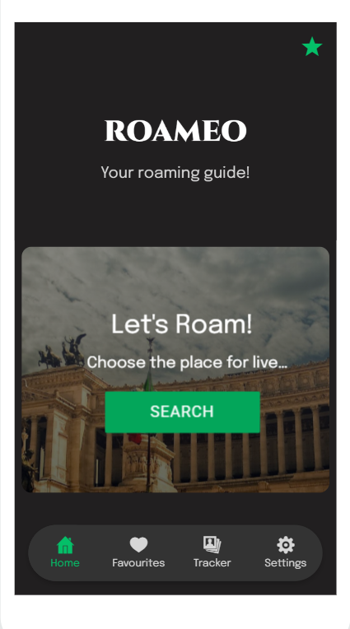
The app ‘ROAMEO’ will be consisting of 3 features-
Live Guide feature that’ll be available through the home page.
The ‘Favourites’ section, and
The ‘Tracker’ section.

Slide 5
LIVE GUIDE – HOME PAGE
WORKING

